Slide 1





ATLIQ HARDWARES
Ad_Hoc Insights

Slide 2



Who are we ?
Atliq Hardware's is one of the leading computer hardware producers in India and well expanded in other countries too.
390+ Products
Operated in 27 Markets
70+ Customers

Slide 3
Products
N&S
Storage
Networking
P&A
Peripherals
Accessories
PC
Notebook
Desktop

Slide 4
Products
N&S
Networking
Storage
Wifi - Extender
USB – Flash Drives
External Solid State Drives

Slide 5
Products
P&A
Peripherals
Accessories
Graphic Card
Battery
Key Board
Internal HDD
Mother Board
Processors
Mouse

Slide 6
Products
PC
Notebook
Desktop
Business Laptop
Personal Desktop
Business Laptop
Gaming Laptop
Personal Laptop

Slide 7
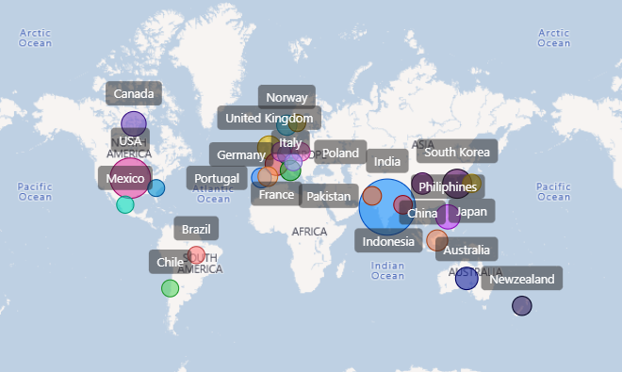
Customers

Slide 8
Customers
Platform
Ecommerce
Brick & Mortar
Channel
Direct
Distributor
Retailer
Our Top 5 Customers are amazon, Atliq e store, Atliq Exclusive, Flipkart, Sage

Slide 9
PROBLEM
Management noticed that they do not get enough insights to make quick and smart data-informed decisions. They want to expand their data analytics team by adding several junior data analysts. Tony Sharma, their data analytics director wanted to hire someone who is good at both tech and soft skills

Slide 10
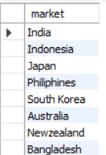
1.
Provide the list of markets in which customer "Atliq Exclusive" operates its business in the APAC region
OUTPUT

Slide 11
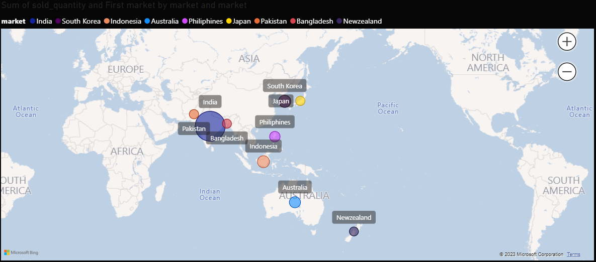

1.
ATLIQ EXCLUSIVE IN APAC REGION
ATLIQ Exclusive operates in the APAC region are:
India
Bangladesh
Philippines
Indonesia
South Korea
Japan
Australia
New Zealand
India has the highest sold quantity in APAC region.

Slide 12

2.
What is the percentage of unique product increase in 2021 vs. 2020?
OUTPUT

Slide 13
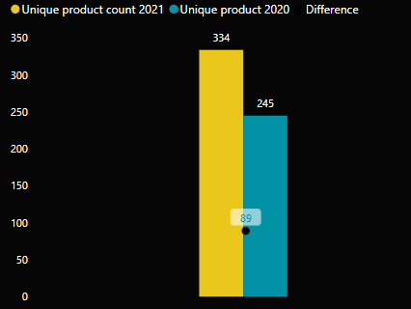
2.
PRODUCT INCREASE FROM 2020 TO 2021
There are about 36.33% increase in year 2020 to 2021
There are about 89 New products in year 2021
A 33.3% increase in a product in a single year can be an encouraging sign
It is important to ensure that each new product meets a customer need and is profitable
It is equally important to monitor the sales performance of the new product.

Slide 14
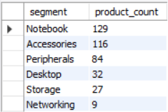
3.
Provide a report with all the unique product counts for each segment and sort them in descending order of product counts.

Slide 15
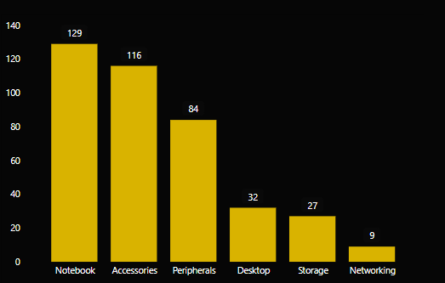
3.
UNIQUE PRODUCTS FOR EACH SEGMENTS
Notebook segment has the highest product compared to other segments.
There are about 397 products in total.

Slide 16
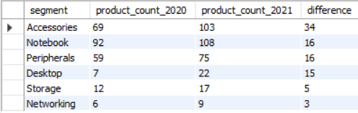
4.
Which segment had the most increase in unique products in 2021 vs 2020?

Slide 17
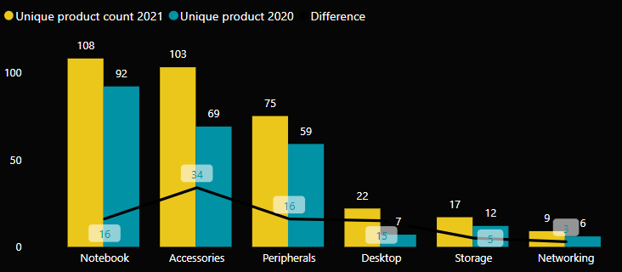
4.
MOST INCREASED SEGEMENT
Accessories segment has the highest product increase compared to other segments.
There is a average of 15 new product increase every year.
There is a increase in sold quantity for accessories product from the year 2020 to 2022

Slide 18

5.
Get the products that have the highest and lowest manufacturing costs.

Slide 19
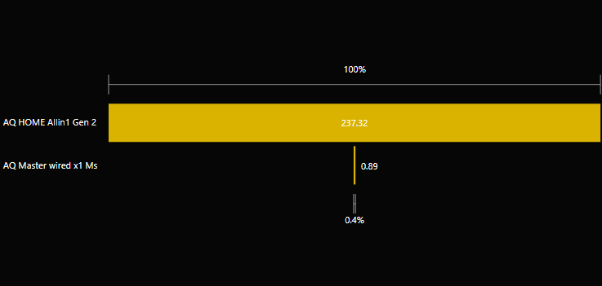
5.
PRODUCTS WITH HIGHEST AND LOWEST MANUFACTURING COST
AQ HOME Allin 1 Gen 2 has the highest manufacturing cost. We sold about 13,833 products.
AQ Master wired x1 Ms has lowest manufacturing cost. We sold about 40,25,721 products.

Slide 20
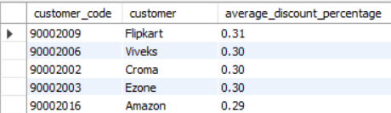
6.
Generate a report which contains the top 5 customers who received an average high pre_invoice_discount_pct for the fiscal year 2021 and in the Indian market.

Slide 21
6.
HIGHEST DISCOUNTED CUSTOMERS
These customers are having an higher discount than average discount
The average pre_invoice_discount is 24%.

Slide 22
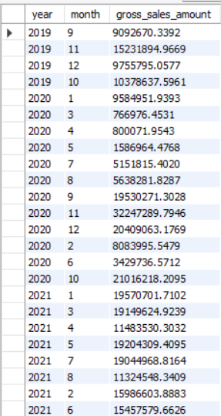
7.
Get the complete report of the Gross sales amount for the customer “Atliq Exclusive” for each month . This analysis helps to get an idea of low and high-performing months and take strategic decisions

Slide 23
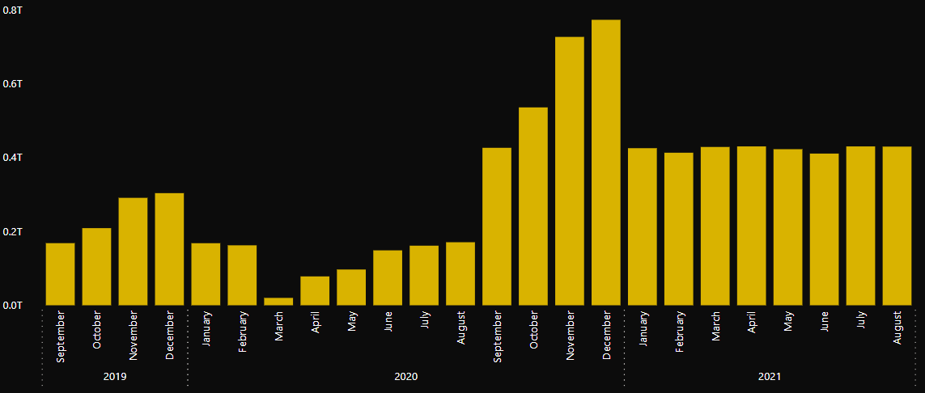
7.
REPORT OF THE GROSS SALES AMOUNT FOR THE CUSTOMER “ATLIQ EXCLUSIVE” FOR EACH MONTH
October, November, December of the year 2020 has a huge sales amount compared to the other months.
Sales were at their lowest during the initial months of 2020, specifically in March and April.
The sales performance has been good after the year 2020, which could be attributed to the introduction of new products.

Slide 24
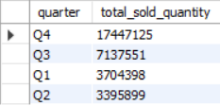
8.
In which quarter of 2020, got the maximum total_sold_quantity?

Slide 25
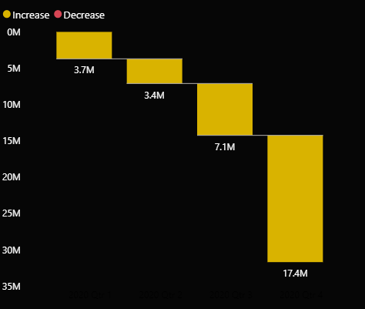
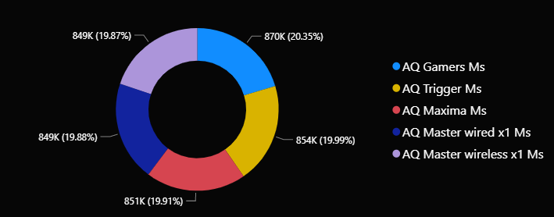
8.
MAXMIMUM SOLD QUANTITY BY QUARTER
Quarter 4 has the highest sold quantity of 17.4M
Quarter 4 has saw the high demand in products in year 2020.
Products that are most sold in this period are AQ Gamers Ms, AQ Trigger Ms, AQ Maxima Ms, AQ Master wired x1 Ms, AQ Master wireless x1 Ms

Slide 26

9.
Which channel helped to bring more gross sales in the fiscal year 2021 and the percentage of contribution?

Slide 27
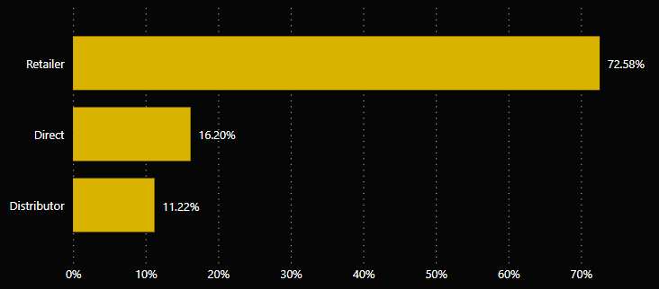
9.
CONTRIBUTION OF SALES BY CHANNEL
Retailer has the highest contribution about 72.58% to our sales
Focusing on retailers to generate more revenue would be a viable strategy, given that they have the highest contribution to sales by channel

Slide 28
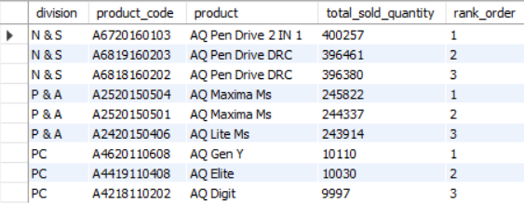
10.
Get the Top 3 products in each division that have a high total_sold_quantity in the fiscal_year 2021?

Slide 29
10.
PRODUCTS IN EACH DIVISION THAT HAVE A HIGH SOLD QUANTITY
N&S division has recorded the highest quantity of sales compared to any other division, and pen drives are the most sold product.
In light of this, it would be a good strategy to increase the production of pen drives this year, as this would likely result in even higher sales for the N&S division.
Additionally, we can consider exploring new markets or expanding their existing customer base to further capitalize on the success of their top-selling product.

Slide 30
Insights
There has been a positive increase in the number of unique products, which can be advantageous for the business.
The accessories segment has recorded the highest increase in the number of products, which can be leveraged to further drive sales.
The sales performance in 2021 was good, indicating positive growth and potential for future success.
Typically, quarter 4 performs well, which can be used to inform business strategy and planning.
The maximum number of sales were for pen drives , which highlights their popularity and potential for continued success.

Slide 31
Thank You

